Slide 1
Rockbuster Stealth Data Analysis project.
OLUWOLE ONI
8/7/2025

Slide 2
Objectives:
Rockbuster Stealth LLC, a former global movie rental chain, aims to transition into the online video rental market to remain competitive against streaming giants like Netflix and Amazon Prime. To support this shift, the management team seeks data-driven insights from its existing customer and rental data to guide strategic decisions for their 2020 business plan and ensure a successful digital launch.

Slide 3
Data Overview
Below is a data overview of key points from within the film, customer, country and city data.
Numbers of films: 1000
Release year(s): 2006, 2019
Rental rate min: $0.99
Rental rate Avg: $2.98
Rental rate max: $4.99
Rental duration min: 3(days)
Rental duration Avg: 5(days)
Rental duration max: 7(days)
Film length min: 46 (mins)
Film length Avg:115.27 (mins)
Film length max:185 (mins)
Replacement cost min: $9.99
Replacement cost Avg: $19.98
Replacement cost max: $29.99
Numbers of G rated films: 179
Numbers of PG-13 rated films: 223
Numbers of PG rated films: 194
Numbers of R rated films: 195
Numbers of NC-17 rated films: 210
Numbers of customer: 599
Numbers of customers created per store#1: 326
Numbers of customers created per store#2: 273
Numbers of countries: 109
Numbers of cities: 600

Slide 4
Key Questions:
Which movies contributed the most/least to revenue gain?
What was the average rental duration for all videos?
Which countries are Rockbuster customers based in?
Do sales figures vary between geographic regions?
Where are customers with a high lifetime value based?

Slide 5
Revenue Gain Per Movie
Movies that contribute the most to revenue gain
This bar chart shows the top 10 revenue-generating movies at Rockbuster. "Telegraph Voyage" leads the list with $215.75, earning significantly more than the others. "Zorro Ark" $199.72 and "Wife Turn" $198.73 follow closely, each generating just under $200. The revenue gap between the 2nd and 5th ranked films is narrow, showing a tight competition among mid-performers.

Slide 6
Revenue Gain Per Movie
Movies that contribute the Least to revenue gain
This bar chart highlights the lowest revenue-generating movies at Rockbuster. 'Texas Watch,' 'Oklahoma Jumanji,' and 'Duffel Apocalypse' are tied at the bottom, each earning just $5.94. Close behind is 'Freedom Cleopatra' with a slightly higher revenue of $5.95.

Slide 7
Revenue by rating and genre
The bar chart shows that PG-13 films generated the highest revenue, with NC-17 films following closely behind.
G rated films has the lowest revenue.
The bar chart shows that the Sports genre generated the highest revenue, followed by Sci-Fi and Animation. While Thriller has the lowest genre revenue.

Slide 8
DESCRIPTIVE STATISTIC
MINIMUM
Rental duration = 3days
Rental Rate = $0.99
Film Length = 46mins
Replacement cost = $9.99
MAXIMUM
Rental duration = 7days
Rental Rate = $4.99
Film Length = $185mins
Replacement cost = $29.99
AVERAGE
Rental duration = 5days
Rental Rate = $2.98
Film Length =115.27mins
Replacement cost = $19.98
On average, Rockbuster videos are rented for 5 days, with a typical rental rate of $2.98. The average film length is approximately 115.27 minutes, and the average replacement cost stands at $19.98.

Slide 9
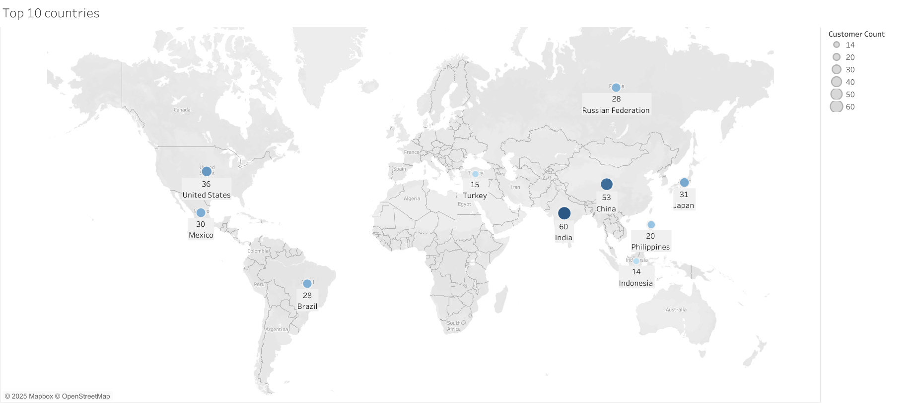
Top 10 countries where Rockbuster has the most customers.
This map highlights the top 10 countries with the highest number of Rockbuster customers. India ranks first with 60 customers, followed by China with 53. Japan and Mexico have 31 and 30 customers respectively, while Brazil and Russia has 28 customer each. Turkey and Indonesia round out the list with 15 and 14 customers, respectively. The distribution reveals Rockbuster’s strong customer base in Asia and Latin America, with India and China representing the largest markets among the top 10.
https://public.tableau.com/app/profile/oluwole.oni2300/viz/Top10rockbustercountry/Sheet1?publish=yes

Slide 10
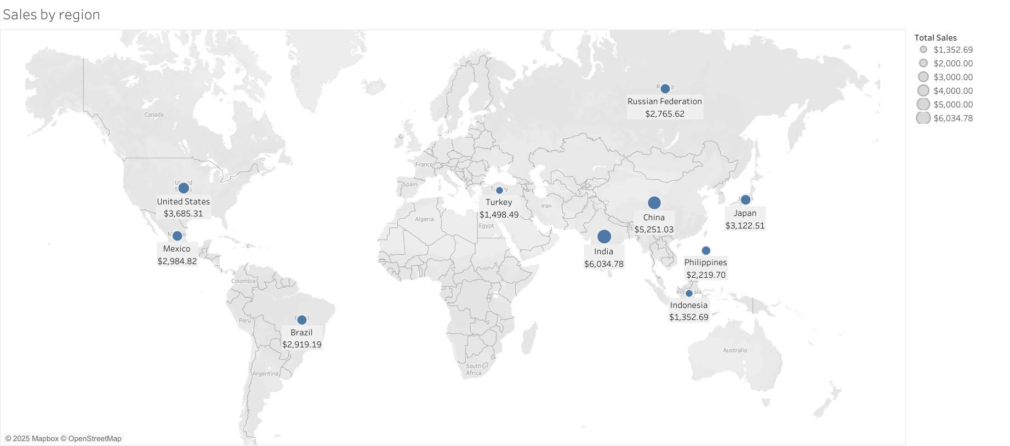
Do sales figures vary between geographic regions?
India leads Asian regions with total sales followed by China and Japan.
The United States top sales in the Americas, followed by Mexico Combined.
Brazil leads in total sales, indicating moderate performance in the South American market.
Russia and Turkey comparatively lower figures highlight that Europe and surrounding regions lag behind Asia and North America in sales performance.
Overall, these regional differences in total sales clearly demonstrate that Rockbuster’s revenue varies significantly across geographic markets. This insight underscores the importance of region-specific strategies to maximize market potential
https://public.tableau.com/app/profile/oluwole.oni2300/viz/Salesbyregion_17544526862710/Sheet2?publish=yes

Slide 11
Where are customers with a high lifetime value based?
The high lifetime value customers are primarily based in the countries displayed in the chart.

Slide 12
KEY INSIGHT
1. Revenue Contributors: The analysis highlights "Telegraph Voyage" as the top revenue-generating movie, followed closely by other PG-13 rated films and titles within the Sports genre, which also performed exceptionally well. In contrast, several movies such as "Texas Watch" and "Oklahoma Jumanji" earned as little as $5.94, suggesting they may be outdated or lack audience appeal.
2. Customer Distribution: Rockbuster’s customer base is strongest in Asia and Latin America, with India and China emerging as the company’s largest and most engaged markets.
3. Regional Sales Variation: Revenue performance varies significantly by region. Asia leads with the highest earnings, driven by strong results in India, China, and Japan. North America also performs well, particularly in the U.S. and Mexico. However, European countries lag behind, contributing less to overall revenue.
4. High Lifetime Value (LTV) Customers: Regions such as Réunion, the U.S., Brazil, and the Netherlands demonstrate strong customer engagement and consistently high spending per user, indicating a concentration of high lifetime value customers

Slide 13
RECOMMENDATIONS
Content Strategy Focus on prioritizing PG-13 and Sports-themed content for the initial streaming rollout. Meanwhile, underperforming titles should be gradually phased out or repackaged to better align with audience preferences.
Regional Marketing
India, China, the U.S., and Japan emerge as key markets for launching the streaming platform, driven by their high revenue potential. Mexico, Brazil, and Russia also show strong growth opportunities and stand to gain from focused promotional efforts. As a result, an aggressive digital launch strategy should be targeted toward Asia and Latin America to maximize market penetration and engagement.
The Philippines, Turkey, and Indonesia offer promising opportunities as emerging markets. Adopt low-cost pricing models to boost sales and profitability.
Customize marketing per region using localized content and cultural preferences.
Customer Retention
Strengthen engagement with high lifetime value customers by implementing loyalty programs, offering premium subscription tiers, and delivering personalized content recommendations tailored to their preferences.
Budget Transition Reallocate budget away from physical stores with fewer customers and toward digital infrastructure

Slide 14
Thank you and i am happy to take any questions or discuss insights regarding any aspect of this presentation.
THANK YOU.

